Slide 1
Online University of the Third Age How to start and realise
Comenius University in Bratislava
Nadežda Hrapková
Dana Havranová
Katarína Grunwald
18. February 2021

Slide 2
INTRODUCTION
Since January 2021, we have prepared the project "Online University of the Third Age" for UTV students and the general public.
We offer education in professional programs in various fields. To complete the webinar, it is necessary to have an email address, a computer with a microphone and speakers, internet connection, a webcam is not a necessary condition.
Students can actively participate in lectures, discuss with teachers and ask questions.
The advantage of Online UTV is education from the comfort of home. Before starting is the training, sending the precise instructions and a simple guide on how to connect.
An IT technician will be available to guide participants by telephone in case of problems.

Slide 3
MARKETING Dissemination
Email to the heads
of the study groups,
contact persons in the
communities
with the link of the
online UTA

Slide 4
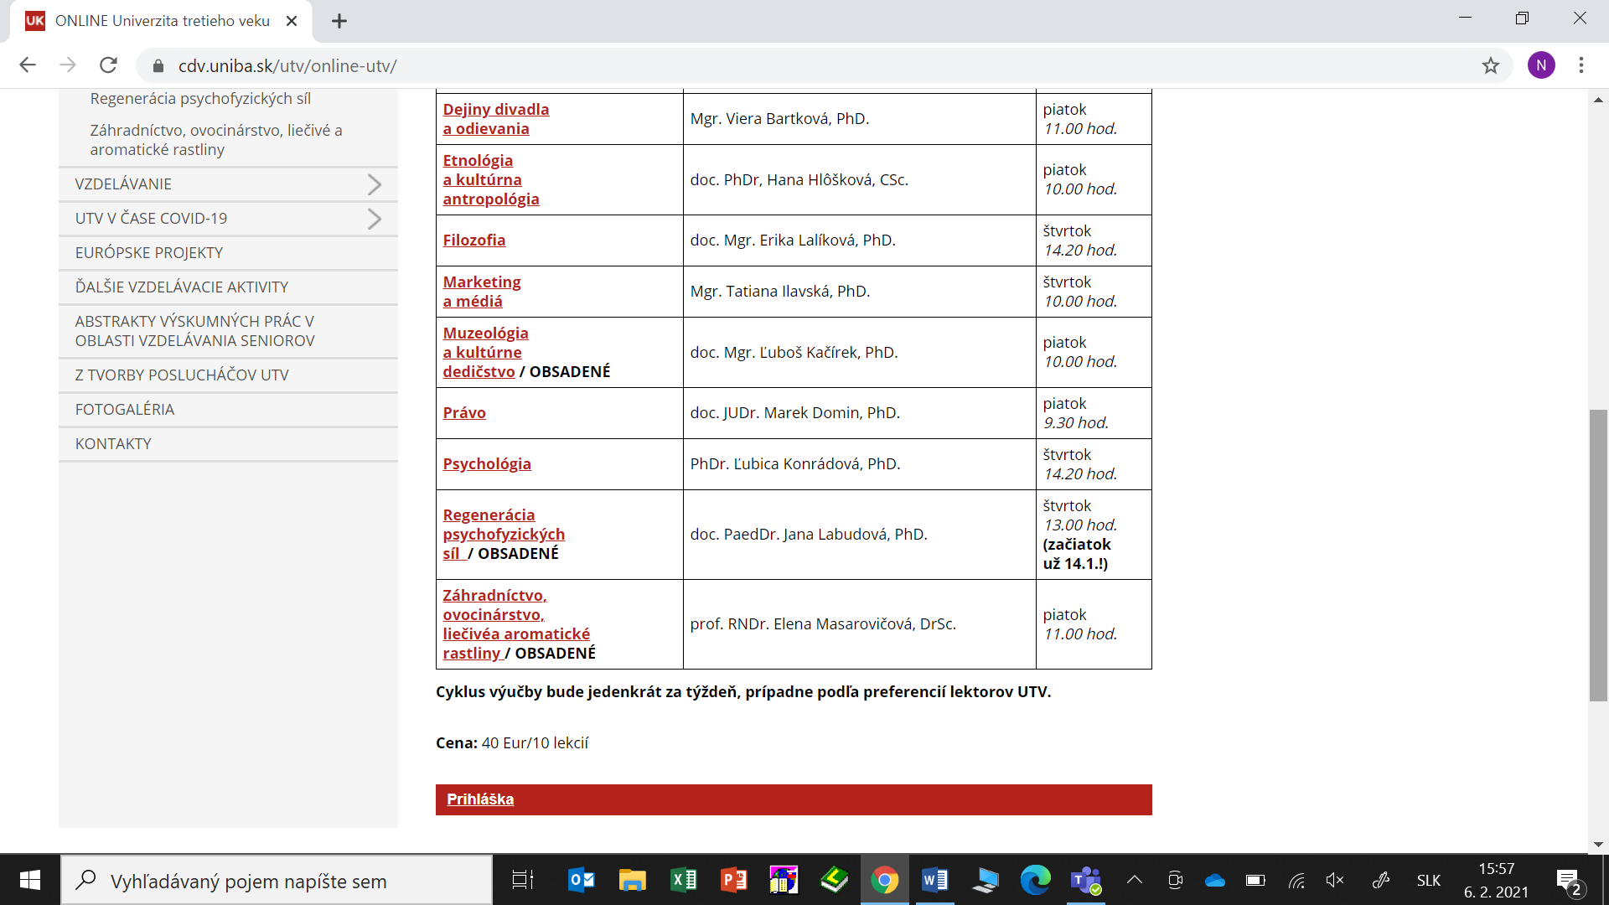
MARKETING Dissemination on the website
Study offer
Registration form

Slide 5
STUDY OFFER
Archeology
Artetherapy
Astronomy
Human in the nature
History of theatre and clothing
Ethnology and cultural anthropology
Philosophy
Marketing and media
Museology and cultural heritage
Law
Psychology
Regeneration of the seniors
Gardening

Slide 6
Specialized subjects and content of the study offer in 10 lectures

Slide 7
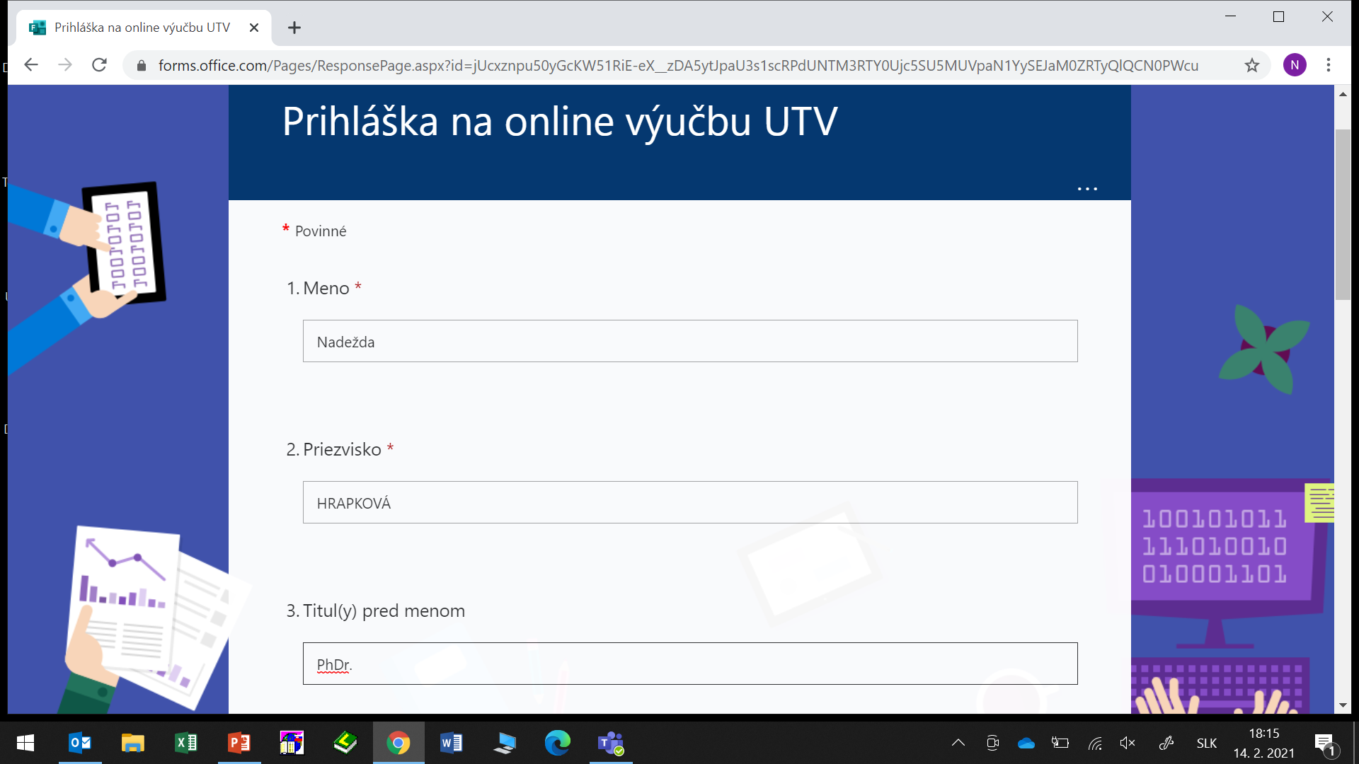
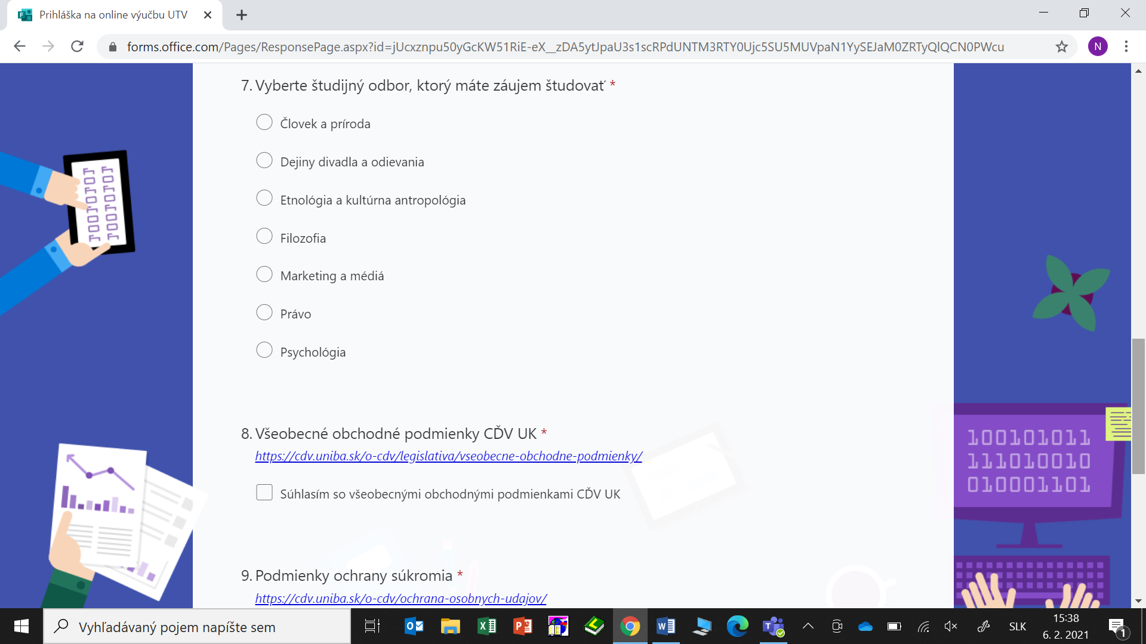
REGISTRATION

Slide 8
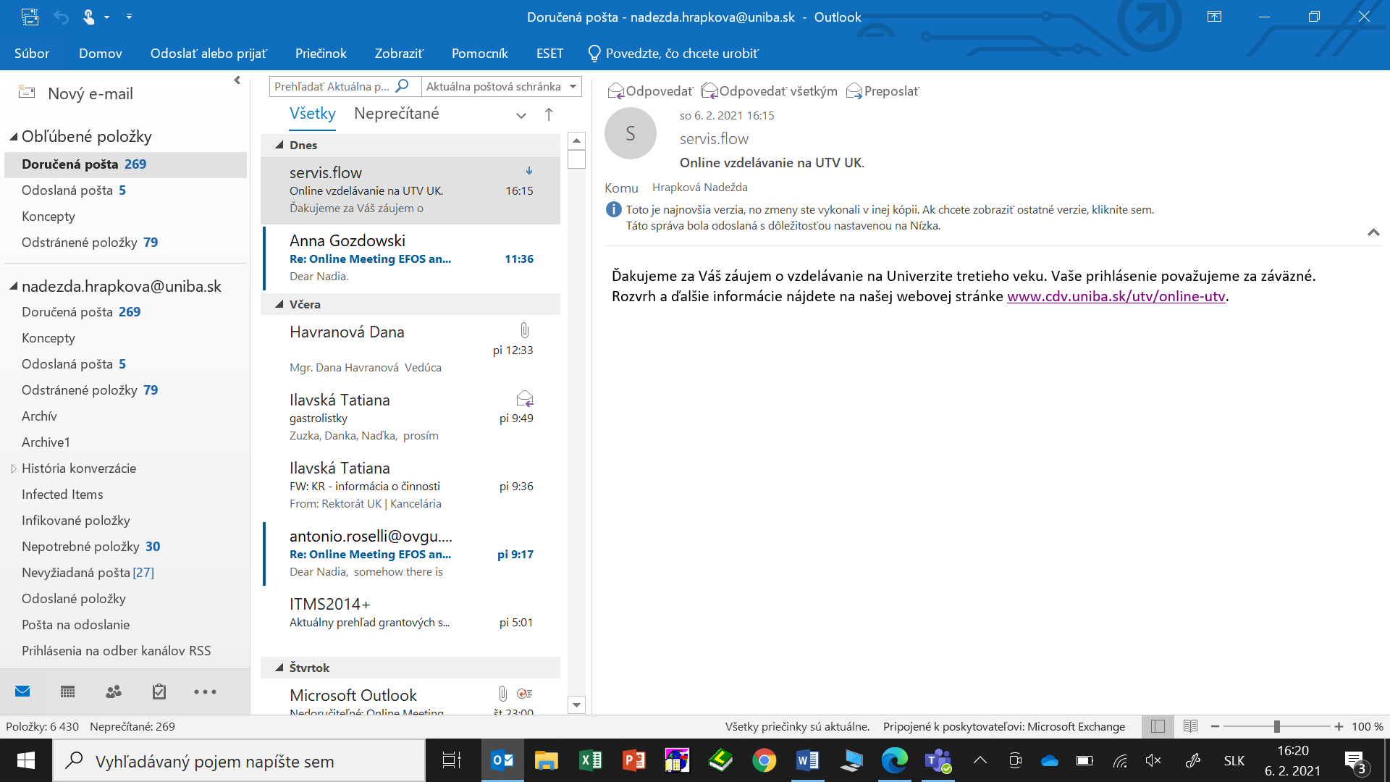
COMMUNICATION WITH THE STUDENTS - after registration, testing before the lecture

Slide 9
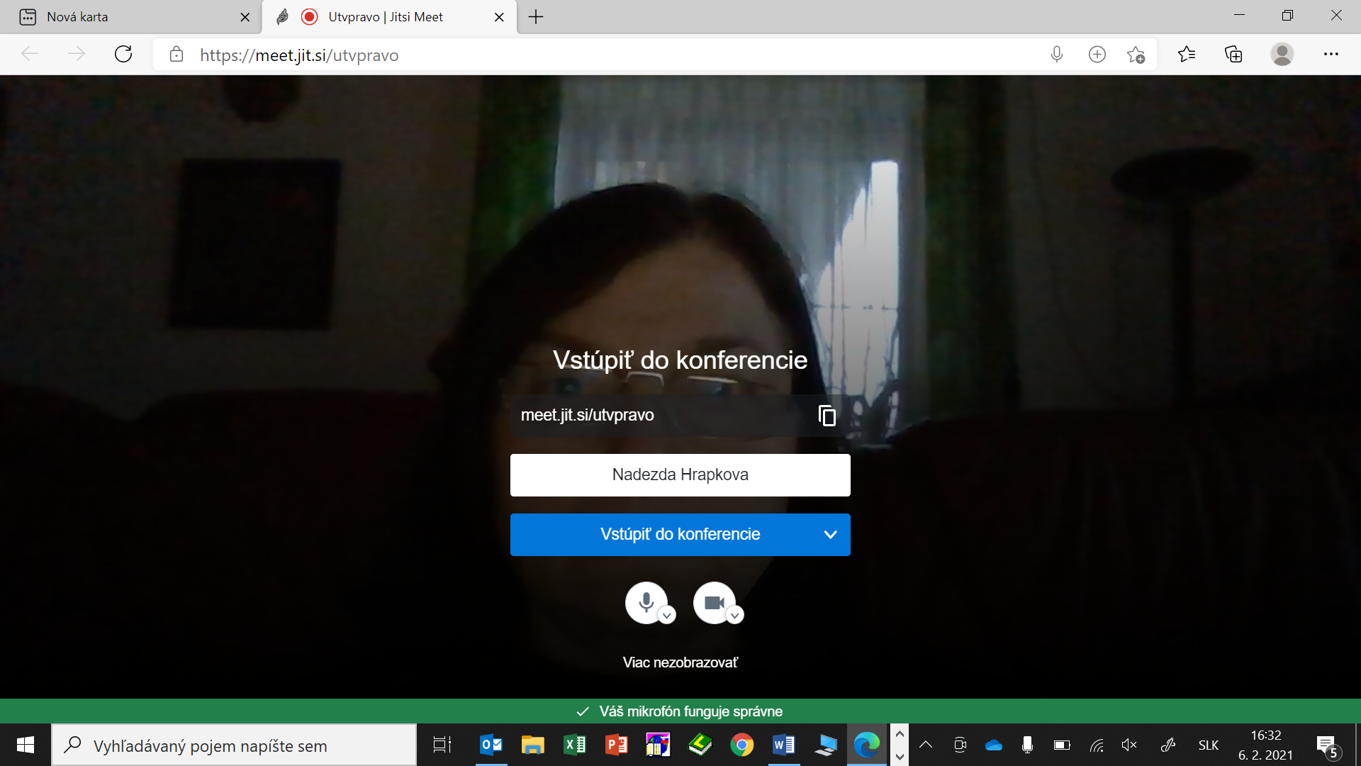
ENTERING AND PARTICIPATION – meet.jit.si password

Slide 10
COMMUNICATION WITH THE LECTURERS
Procedure the similar to the regular study programs:
Contract on the part time work
Content of the study subject is specially prepared according to the interest of the teachers / lecturers
Some without the skills on IKT needed help, seminary room, PC
Without help of university IKT specialists we would not be able to realize online learning with seniors

Slide 11
SUMMARY OF THE STUDY SYSTEM
Regular study programmes:
40 study subjects
250 lecturers / teachers
2000 senior students
Lecture each 14 days
14 lectures
Online study programmes:
13 study subjects
lecturets / teachers
250 senior students
Lecture each 7 days
10 lectures

Slide 12
ARTETHERAPY – AIMS in the time of the pandemic, U3A at the UK is offering online courses to reduce the isolation of the elderly and to stay mentally fit.
Individual goals - relaxation, self-awareness, learning about one's own possibilities, arranging experiences, developing imagination and general personality development, self-realisation.
Social goals - awareness and acceptance of other people, recognition of their value and worth, participation in the group - working together, reflection on one's own functioning in the group.
Art therapy does not focus on the end result, the process of creation is important.

Slide 13
ARTETHERAPY – AIMS in the time of the pandemic
We are a group of seniors who are enthusiastic about artetherapy. Our lecturer Mgr Danka Havranova gives us a theme of what we should paint. It does not have to be a work of art, but it should reflect our momentary feeling on the page. Our "works" are analysed, whereby some of the qualities, dreams, wishes... hidden deep inside us come to light. It is important to know that in our group there is no need to be inhibited about the "diagnosis" we are told.
It is very interesting but also helpful and liberating to draw the situation we are in and then to be able to name it aloud. Katarina Grunwald, participant

Slide 14
Thank you for your attention

