Slide 1
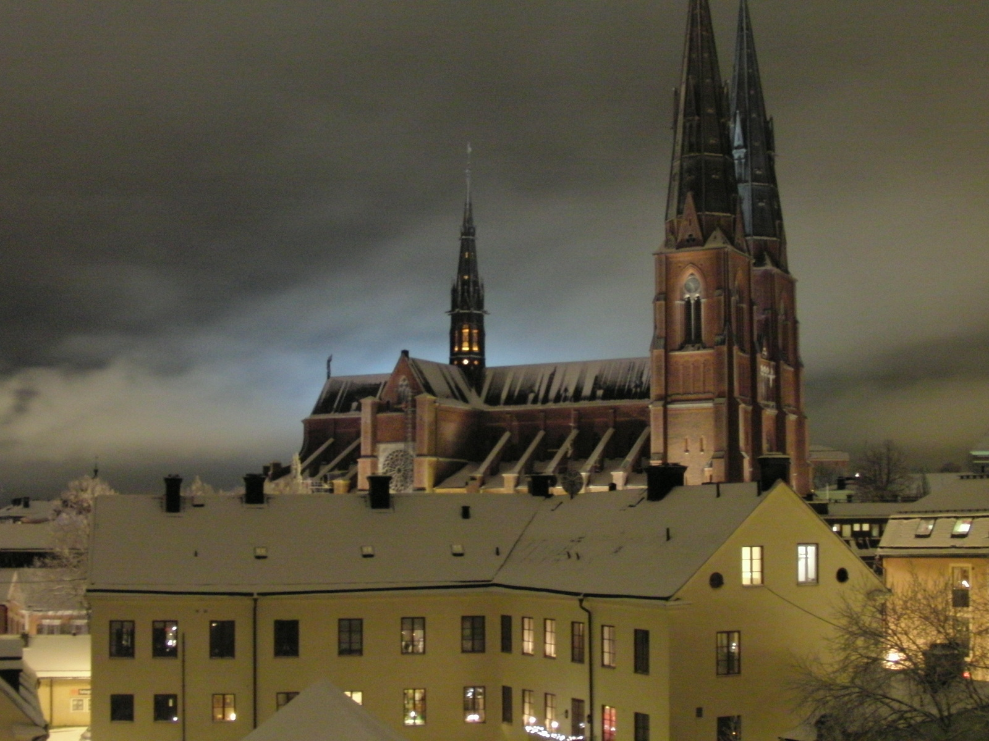
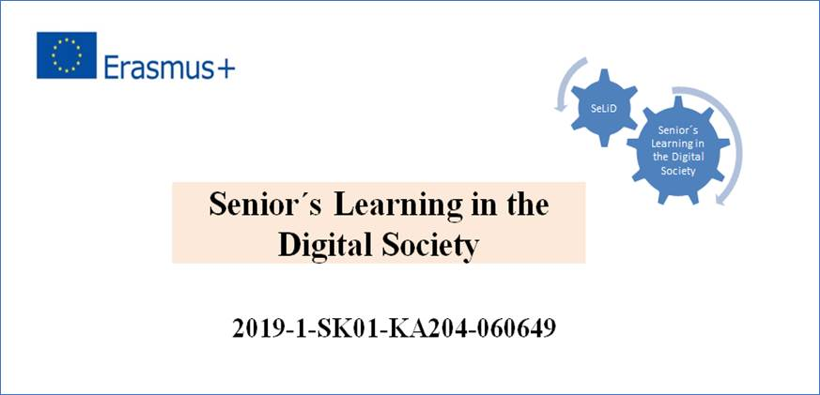
Uppsala Report: Survey Autumn 2020
Benny@Eklund.nu

Slide 2
Full scale use of Zoom at Uppsala University of the Third Age (USU)
Circle leaders received training in Zoom
Also members at USU were offered training in Zoom before the start of the course, which many took advantage of.
50 study circles were started with 486 paying members and 19 study circle leaders.

Slide 13
Conclusions
Digital teaching has made it possible for more than 400 members at Uppsala University of the Third Age to be able to continue their study circles during the autumn of 2020.
Members have also increased their digital skill.
The survey results suggest that the planning of future programs should be characterized by flexibility
Digital education should complement traditional teaching in premises where it’s appropriate.

