Slide 1
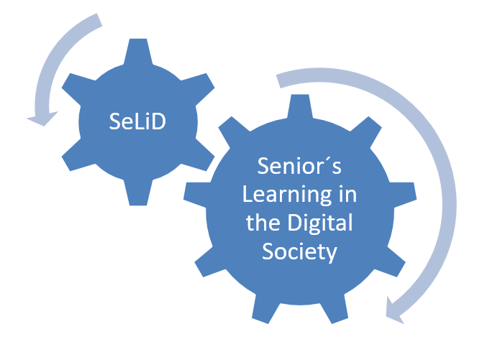
SeLiD Meeting
24.09.2021, Dresden
Lenka Shromáždilová
Michal Vojkůvka

Slide 2
Academic Year 2020/2021
The winter semester of the academic year 2020/2021 was prepared for face-to-face teaching at the University of the Third Age. Unfortunately, due to government measures, we didn't start classroom teaching at all.
The guarantors of the technically oriented courses prefer face-to-face teaching. For this reason we have moved these courses to the next academic year 2021/2022.

Slide 3
Academic Year 2020/2021
We have been providing distance learning only which has met with little interest.
Only a few students (about 15 percent) attended in the distance learning.
The tools used in this form of learning were WEB pages, MS Teams application and YouTube.

Slide 4
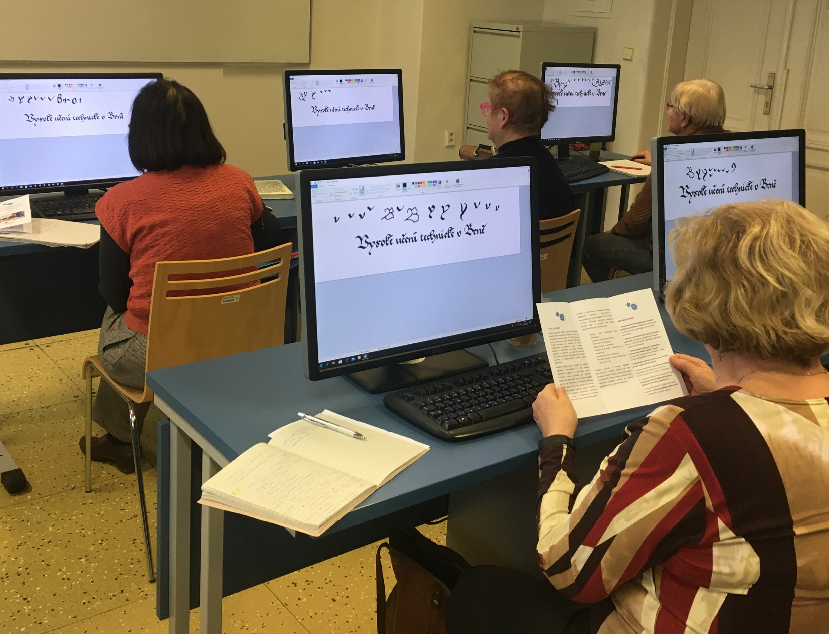
Current Situation Academic Year 2021/2022
Classroom teaching has been resumed. (in September 2021)

Slide 5
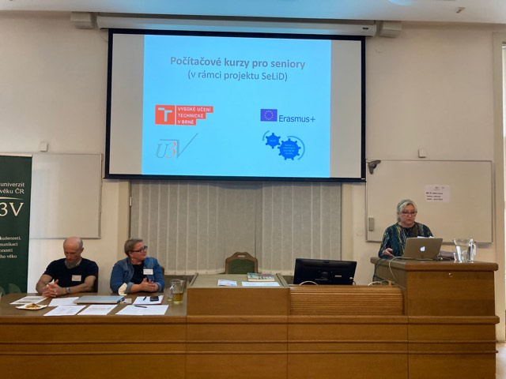
SeLiD Dissemination Association of the Universities of the Third Age (AU3A) Czech Republic
The AU3A CR is a non-governmental, not-for-profit organization affiliating all parties interested in senior education at Czech universities. More than 40 universities (faculties) in the Czech Republic are members of the organization.
General meeting in September 2021:

Slide 6
THANK YOU FOR YOUR ATTENTION

